Slide 1
Charlotte Bots & AI
First Meetup

Slide 2
Learn / Build
Bots and Artificial Intelligence based applications

Slide 3
About Me
Ramu Pulipati
Engineer
Working on hibot.co to build and host chatbots

Slide 4
Introduction
Bots are Smart and Intelligent programs that live standalone or within a software to perform specific set of tasks
--
Chatbots are a kind of bot that enable user conversations

Slide 5
Examples
Amazon Alexa personal assistant
Order Flowers over Facebook
Server status over Slack
In-store help for Big box stores
Customer support over Web
Bank orders
Flight reminders
Meeting Notes taker on Skype

Slide 7
Demo
Facebook Messenger
CNN
1-800-Flowers

Slide 8
Traits of a Chat Bot
Personalization
Context Sensitive
Location Awareness
Adaptive
Predictability
Connectivity

Slide 9
Why now?
Usage of messaging has exploded over the years and bots provide quick access to personalization

Slide 10
Platforms with Bots
SMS
Amazon Alexa / Google Home / iOT
Facebook/Skype/Slack/Telegram
Rocket Chat/Roll your own
https://cdn.sameroom.io/chat-timeline.pdf

Slide 11
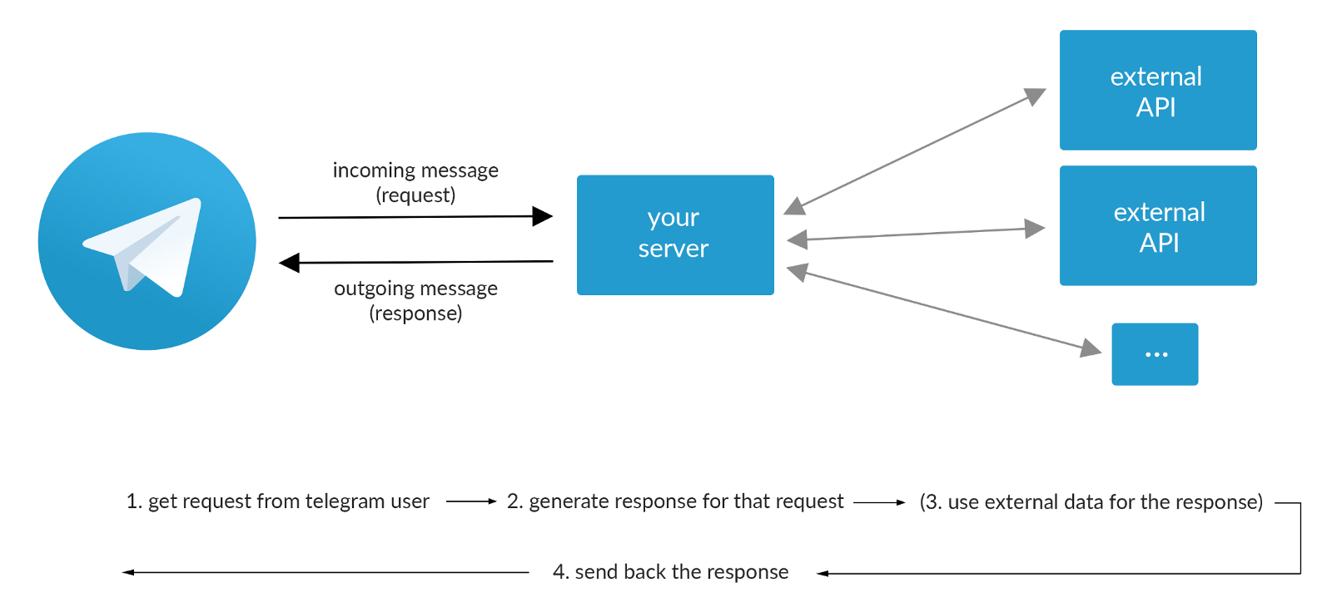
How Bots work?
Source: chatbotweekly.com

Slide 12
Building Bots
Botkit or Microsoft Bot Framework
Facebook wit.ai for AI based flows
NLP: Aylien, Microsoft & Google
Visual chatbots using Motion.ai
Microsoft Flow or Zapier or CloudPipes for integrations
Roll your own for specific platform

Slide 13
Artificial Intelligence
Guided flow – Not really AI (Facebook)
NLP – Varies on context (APIs available)
Machine Learning – Feedback loop
Deep Learning, Computer Vision, – Needs separate discussion

Slide 14
Build a basic Slack bot
Botkit framework
Slack

Slide 15
Next Meetup?
Alexa Bot
Facebook Messenger Bot
Bot Analytics
Build Motion.ai chatbot
NLP and deep learning techniques

